Slide 1
Campus administration
Navruza Tulkunova
Aleksey Yakovlev
Roman Tokarev
Mo Haoran

Slide 2
Main features
Personnel attendance control
Guest control
Students and personnel documents maintenance
Payment control
Access control
Apartments’ occupation control

Slide 3
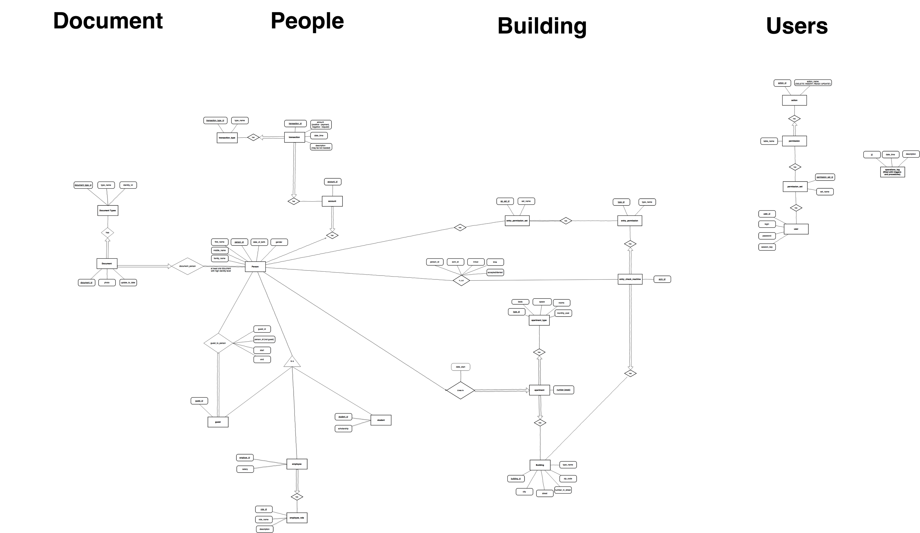

Slide 4
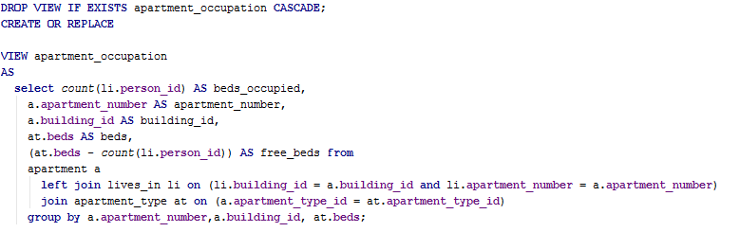
Apartments occupation

Slide 5
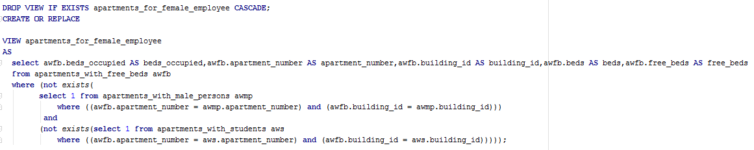
Apartments for male employees

Slide 6
Technologies
PostgreSQL
JavaFX
JDBC

